Slide 1
Lyngsoe
Automated
Validation
Station™
POSTAL & LOGISTICS LYNGSOE SYSTEMS COMPANY PRESENTATION

Slide 2
LYNGSOE AUTOMATED VALIDATION STATION™
Logistics Automation Modules
Off-Shelf product
Based on a building block concept
Easy to install
Integration into your existing processes
Modules can be implemented individually or as a coherent process
Concept can be customized to fit the individual customer
Scalable; start with a pilot at one process

Slide 3
AVS STATION
Self-contained solution that works with current GS1 standards or similar industry standards
Cloud based solution – no on-premise software installation needed
Operated on a tablet
Scalable – add more gates, expand with destination, load, arrival and item scanning
WIRELESS
RFID
PORTAL
MOBILE,
SELF-
SUPPORTING
GANTRY
TABLET WITH
EMPLOYEE
LOADING THE
TRUCK

Slide 4
AVS APPLIED IN SUPPLY-CHAINS AT SSCC LEVEL

Slide 6
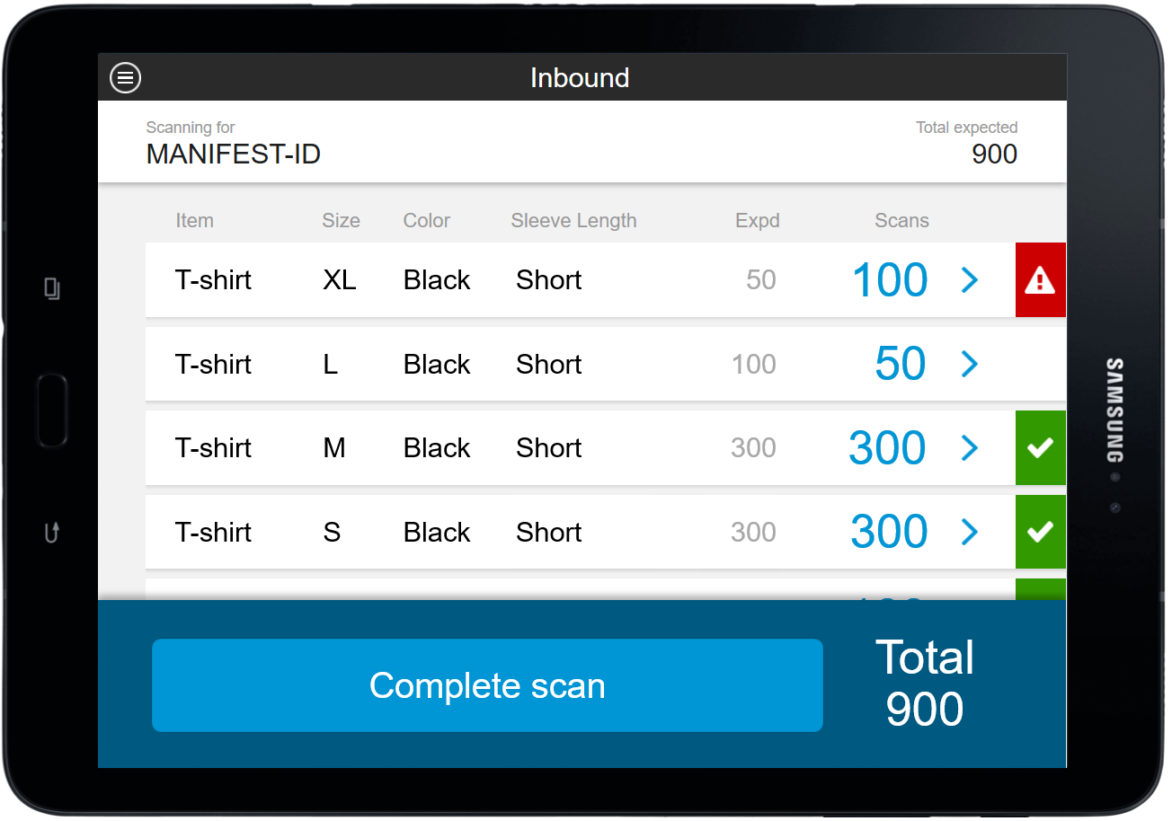
2
VALIDATION: CONTENT
Shown here at item level

Slide 7
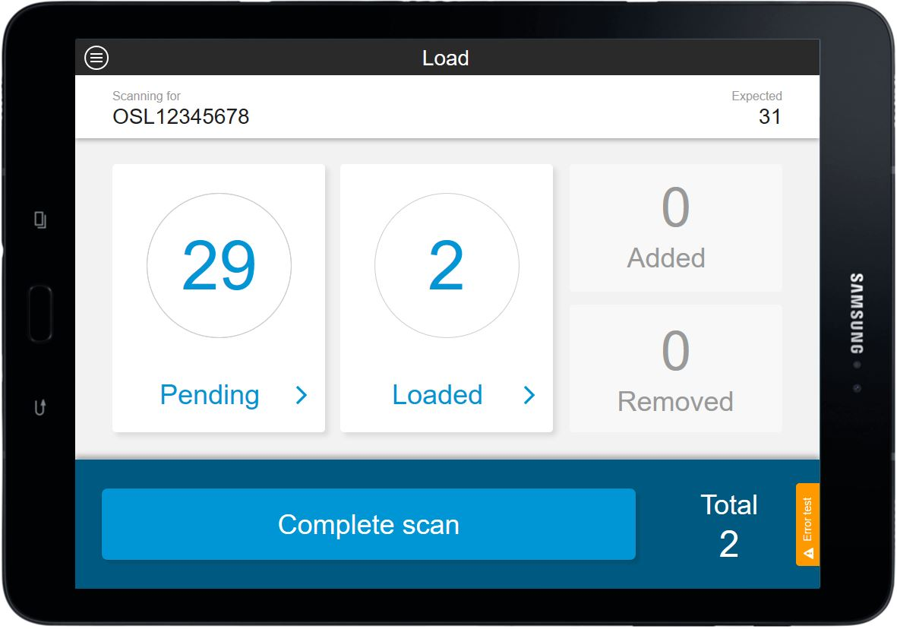
3
VALIDATION: LOAD

Slide 10
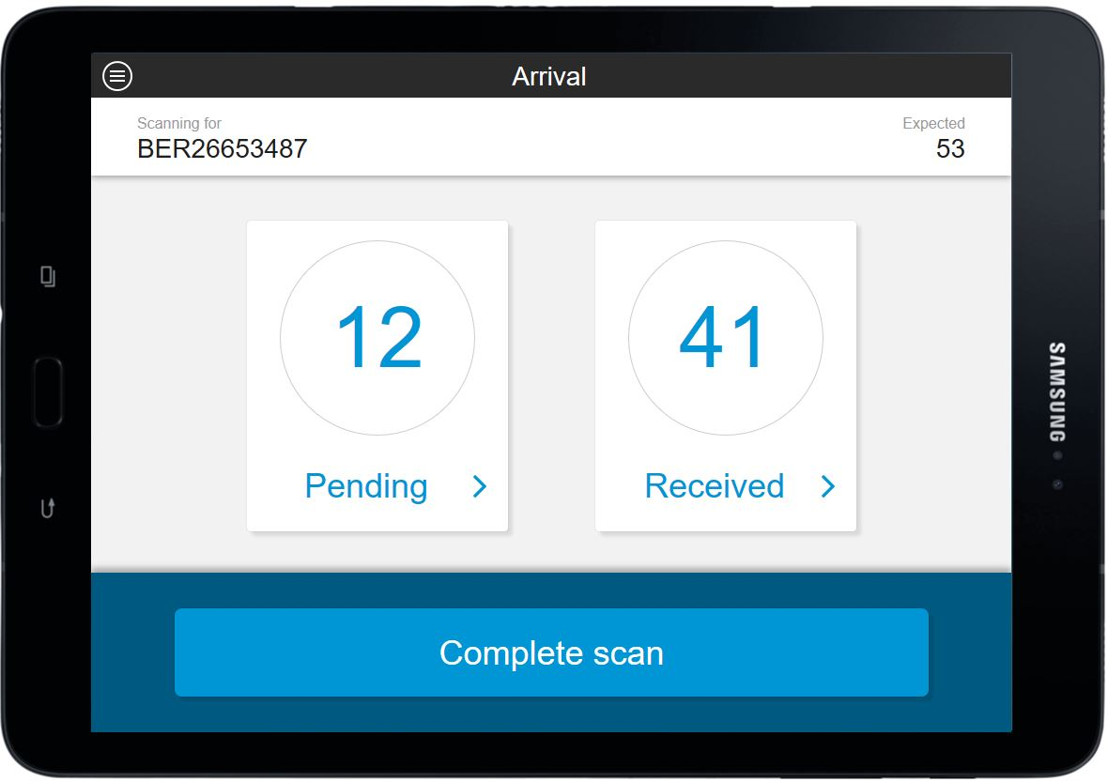
4
VALIDATION: ARRIVAL

Slide 12
ISOLERE PROCESSER!?

Slide 13
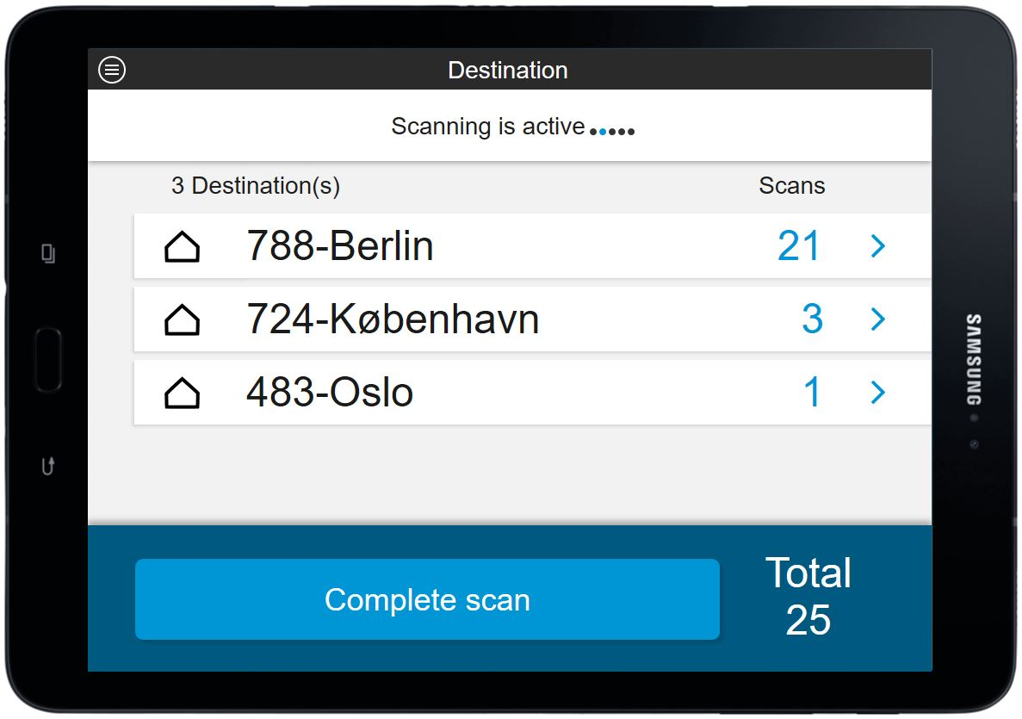
7
VALIDATION: DESTINATION

Slide 14
ISOLERE PROCESSER!?

Slide 16
AVS APPLIED IN SUPPLY-CHAINS AT SSCC LEVEL

Slide 17
CHALLENGES
SHIPMENTS MISPLACED, DELAYED, MIS-DIRECTED
– COST OF CORRECTIONS
– COST OF CUSTOMER DIS-SATISFACTION
TRANSFER OF LIABILITY
– COST OF REIMBURSEMENT
– COST OF TIME TO SEARCH
SOLUTION: VALIDATION
REDUCED MISPLACED & DELAYED SHIPMENTS
– COST AVOIDANCE
IMPROVED CUSTOMER SATISFACTION
– IMPROVED COMPETITIVENESS
– COST AVOIDANCE
LIABILITY TRANSFER AT THE GATE
– COST AVOIDANCE
DIRECT
VALUE CREATION

Slide 18
ITEM LEVEL
AUTOMATIC STOCK REGISTRATION
ACCURATE STOCK DATA
ACURATE PRODUCT AVAILABILITY
INCREASED SALES
SSCC LEVEL
AUTOMATE SCANS - REDUCE MANUAL
IMPROVE DOCUMENTATION - FLOW/HANDOVER
AUTOMATIC ARRIVAL REGISTRATION
AUTOMATIC DEPARTURE REGISTRATION
IMPROVED TRACKING NOTIFICATION
IMPROVED CUSTOMER SATISFACTION
VALUE CREATION
OPPORTUNITIES

Slide 19
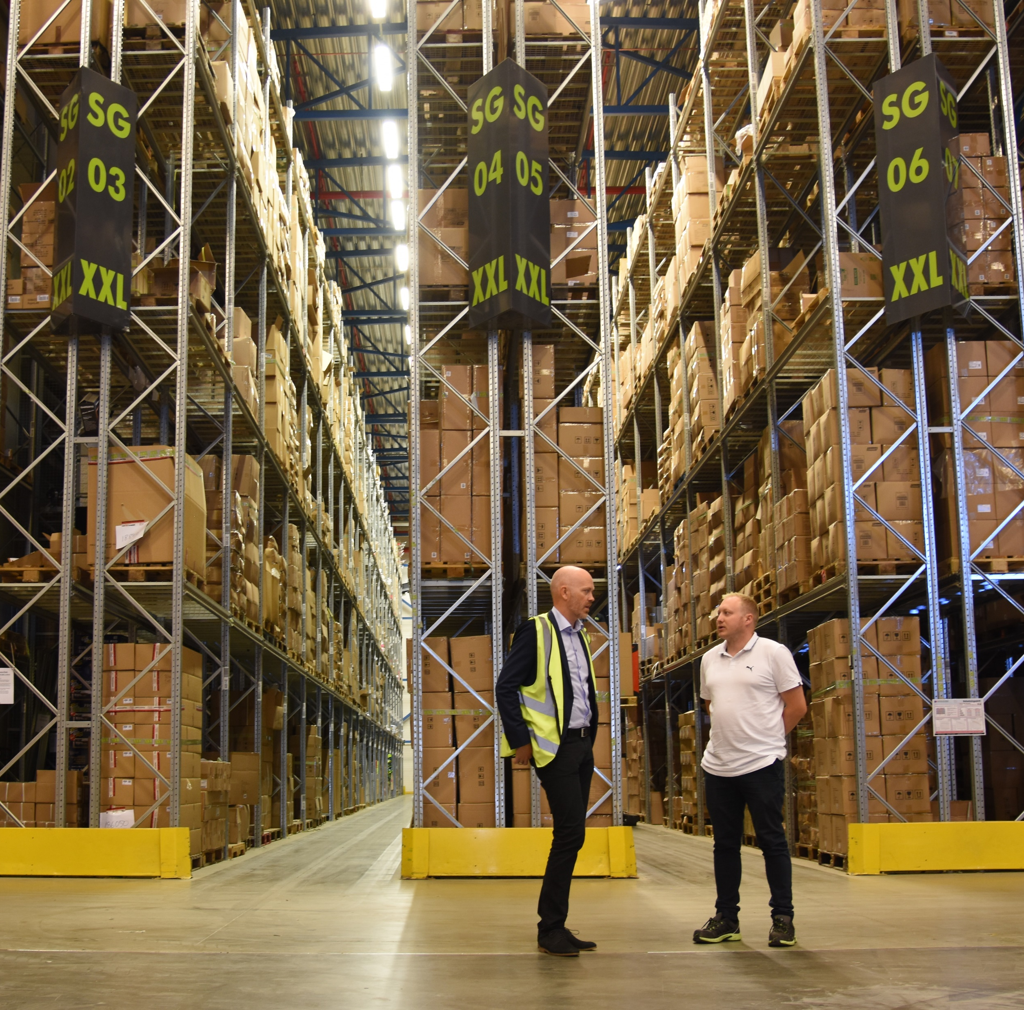
Combining the Validation Modules destination & arrival
CASE STORY
XXL Sport
Biggest sports retail-chain in the Nordics
Over 50 department stores and 10 new stores opened every year
Shipping 25.000 packages every month
Looking improve their logistics performance

Slide 20
XXL SPORT Implementing
Automated Validation Station
BEFORE
looking to improve fulfilment process related to ‘mailbox package’ and ‘pick-up at store’
Gap between their WMS and TMS systems
Manual scanning all packages at departure and upon arrival in store
Packages sent to the wrong destination
Documentation of hand-over to carrier (liability)
Too many steps in the fulfilment
NUMBER OF SHIPMENTS
25.000
Parcels shipped pr. month
APPROX ERRORS PR. MONTH
125
Shipment errors pr. month
TIME USED PER PARCEL
1 min.
Time used for departure and arrival scan per parcel
COST IN FOCUS
1.100.000 NOK
Yearly labor cost handling 25.000 shipments pr. month

Slide 21
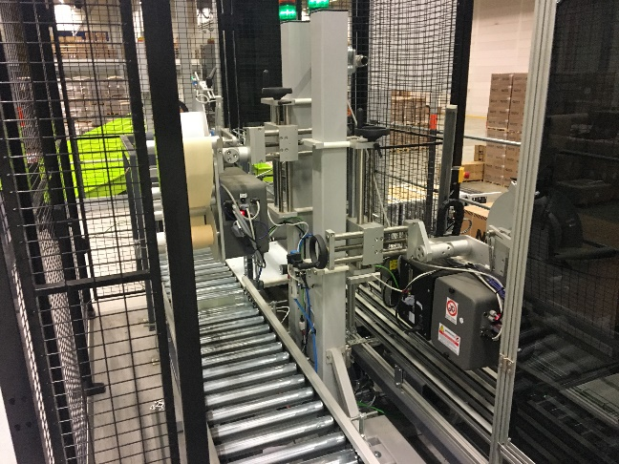
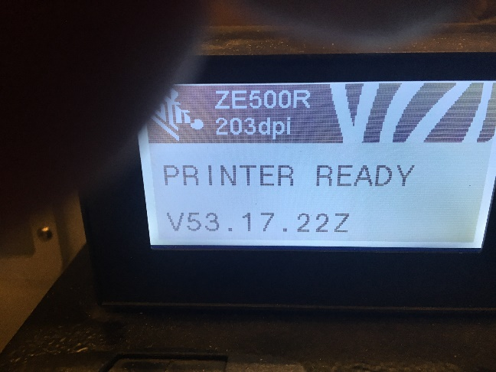
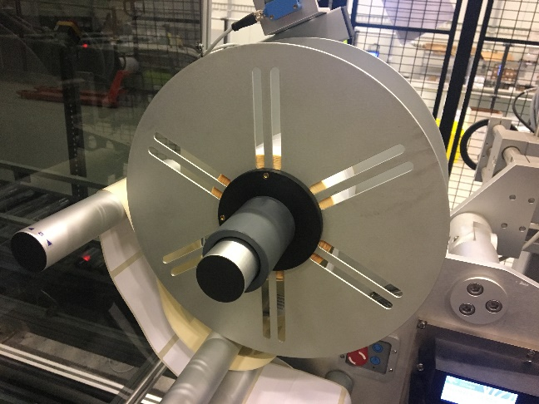
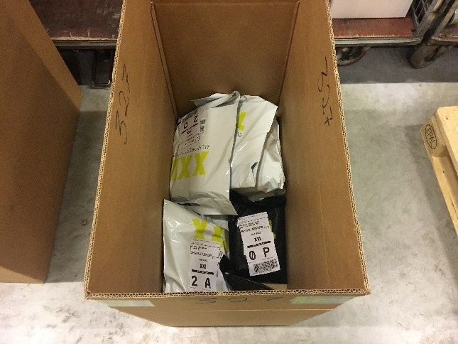
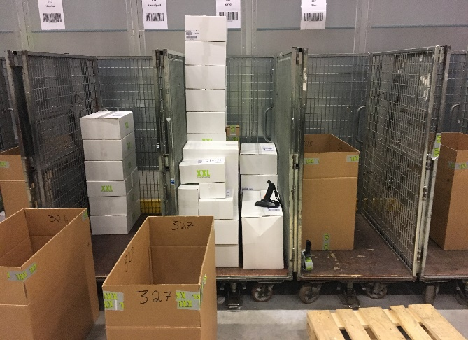
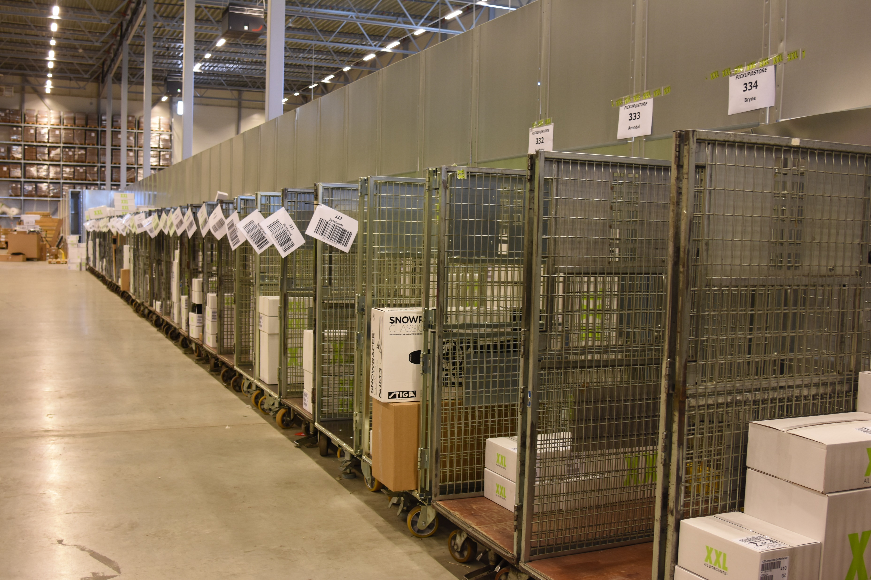
Pictures from XXL Warehouse site
XXL WAREHOUSE PICTURES
Avs AT SSCC LEVEL

Slide 22
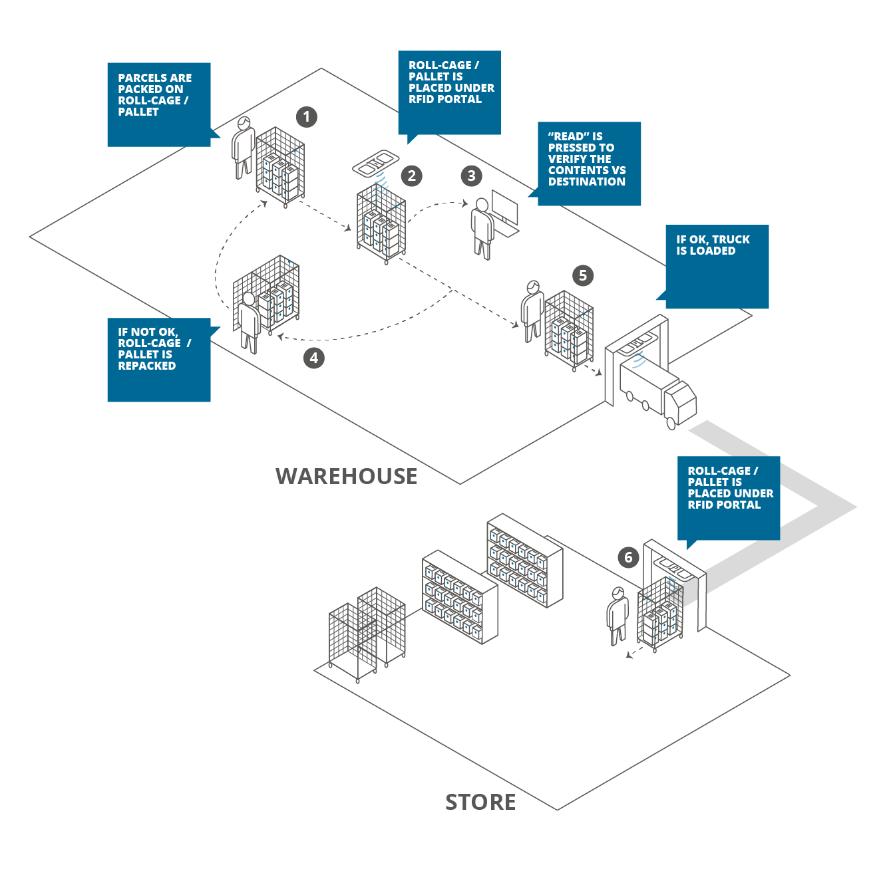
Illustration from XXL
IMPLEMENTED SOLUTION
Shipping accuracy with automated validation
Reduced labor as shipping data is captured automatically
Customer notifications

Slide 23
Illustration from XXL
IMPLEMENTED SOLUTION
Shipping accuracy with automated validation
Reduced labor as shipping data is captured automatically
Customer notifications
“It costs a lot of money to correct a misdelivered order, even if it’s for one of our own stores. Also, it causes great frustration for our Guests [customers] and us when we can’t deliver at the scheduled time. With RFID we avoid this from happening.”
Kim Andre Nilsen, Logistics Manager E-commerce, XXL Sport & Villmark

Slide 24
Implementing Automated Validation Station
AFTER
RESULTS ACHIEVED
Remove time-consuming manual scans
Saving time - Cost avoidance
Automatic verification of shipment content
Reducing errors – Cost avoidance
Documentation of handover to carrier
Transfer of liability – Cost avoidance
Automatic real-time tracking notifications
Improved customer satisfaction – Revenue retention
COMPLAINTS REDUCTION
50 %
Reduction in customer complaints in %
REMOVED HANDLING
80 %
Less handling of shipments per month in %
SAVED TIME PR. PACKAGE
50 sec.
Saved on arrival and departure per parcel
ROI
1,04 Year
Payback period - Year

Slide 25
Reference case
Delta Airline

Slide 26
CASE
Delta, IATA
Passive RFID for baggage tracking and aggregation of Passenger to BSM
https://www.youtube.com/watch?v=byLJYMlYKoA
https://www.youtube.com/watch?v=1xj_FhDhHOs
Copyright
All rights reserved

Slide 27
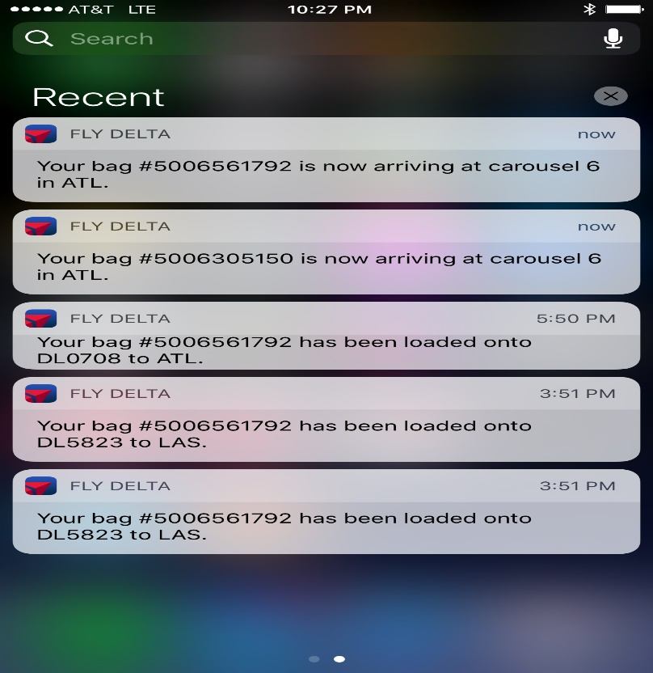
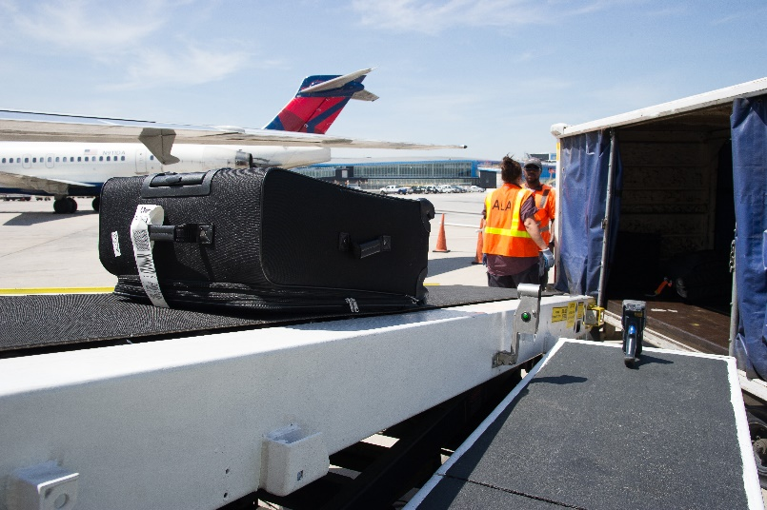
Challenges
1 lost bag cost + $100
Passenger dissatisfaction with baggage loss looses repeat business
IATA complaince, resolution 753
Solution
Automated scanning on 350 million bags per year
Real time customer tracking notifications
Load control for IATA compliance
Value
5-10% reduction in mishandled bags
FTE cost out in loading operations
Industry savings over next 7 years up to $3 billion
Copyright
All rights reserved

Slide 28
Contact information
Christian Meinhardt
Sales Director, Retail & Logistics
CME@lyngsoesystems.com
Direct: +45 41742400
IM: CME@lyngsoesystems.com

